Slide 1


GG Plot
SUNDEEP RAVICHANDER
OIM7502

Slide 2
What is GGplot
ggplot is a Python library that provides an interface for creating beautiful and informative visualizations. It is based on the grammar of graphics, a powerful framework for describing and building visualizations.
Plotnine is a Python data visualization library built on the principles of the Grammar of Graphics, the same philosophy that powers ggplot2 in R. It allows users to create complex plots by layering components such as data, aesthetics and geometric objects.

Slide 3
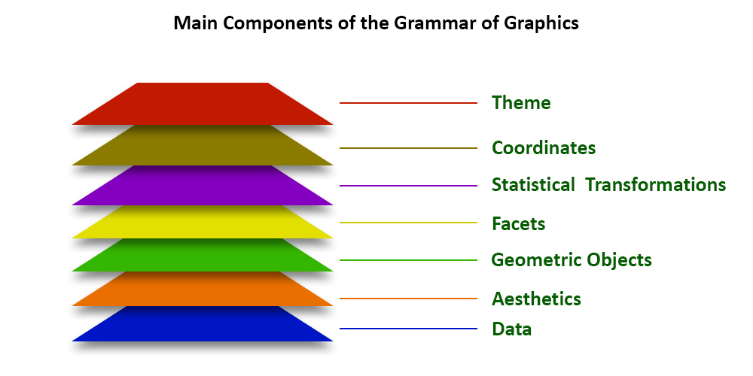
Grammar of Graphics
Purpose and Functionality
Introduced by Leland Wilkinson.
A visualization framework that defines how graphics represent data.
Every visualization can be broken into seven layers:
1. Data
2. Aesthetics
3. Geometric Objects
4. Statistical Transformations
5. Scales
6. Coordinate Systems
7. Facets

Slide 4
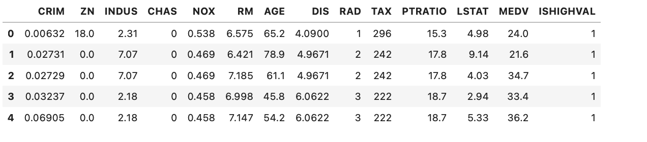
Layer 1: Data
Purpose and Functionality
The dataset is the foundation of the visualization.
In Plotnine, data is passed inside the ggplot() function.
Example:
df = pd.read_csv('BostonHousing.csv')
ggplot(df)
Defines the source but no visual output yet.

Slide 5
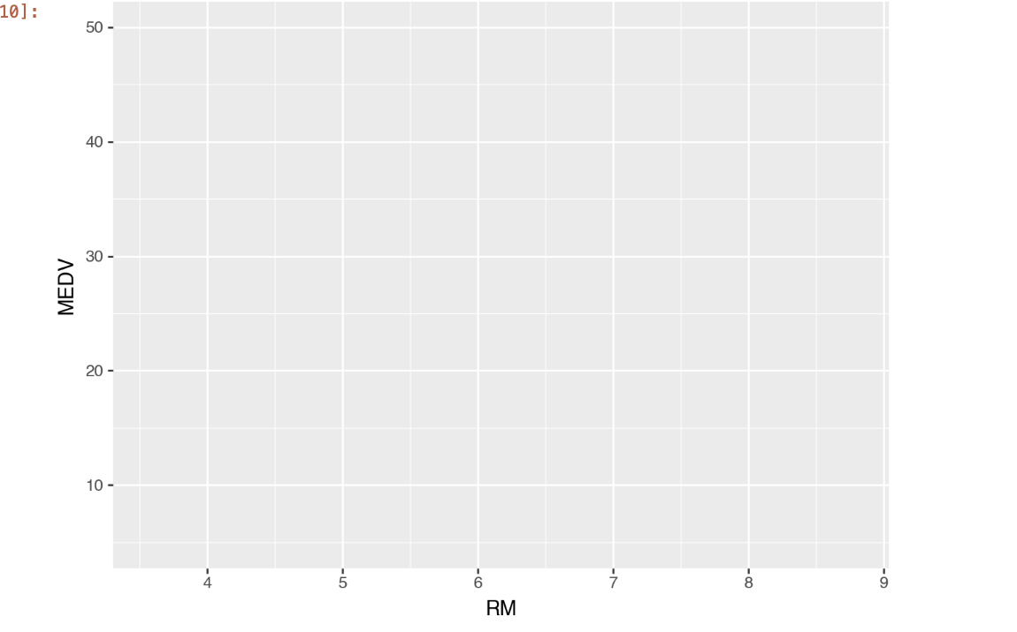
Layer 2: Aesthetics
01
Aesthetic mappings describe how data variables map to visual properties.
02
Common aesthetics: x, y, color, size, shape, fill.
03
ggplot(df) + aes(x='RM', y='MEDV')
Links average number of rooms to median home value

Slide 6
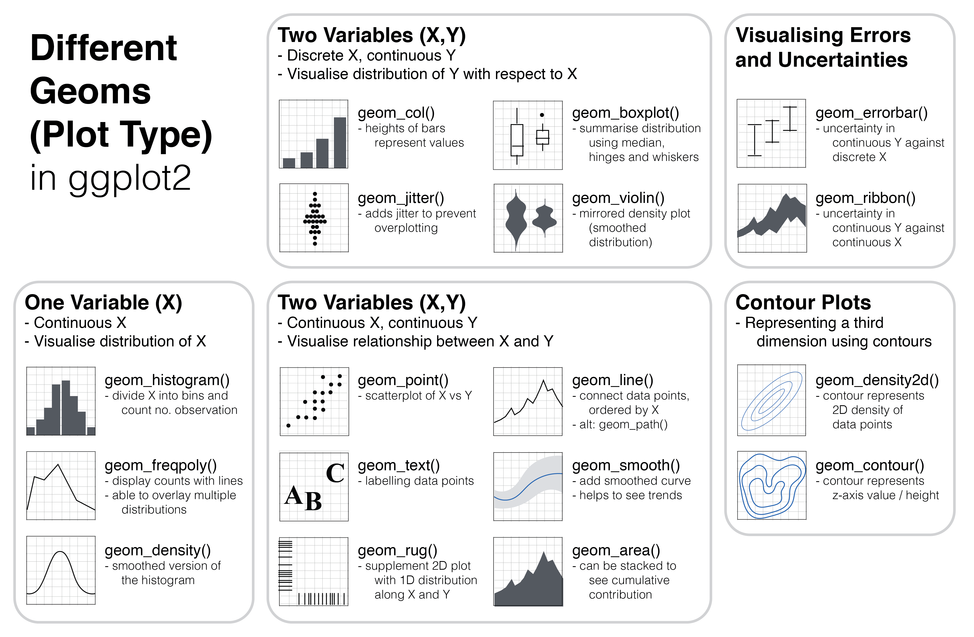
Layer 3 Geometric Objects
Geoms define the type of visual mark (point, bar, line, box, etc.)
Each geom layer adds a visual representation.
Examples:
geom_point(): scatterplot
geom_histogram(): histogram
geom_boxplot(): box plot
geom_area(): Used for creating area plots, filling the area under a line.
Multiple geoms can be layered together for richer visuals.

Slide 7
Layer 4&5 :Statistical Transformation. & Scale
Statistical Transformation :Specify computations and aggregations to be applied to the data before plotting it.
Example: geom_histogram() uses stat_bin to create bins.
Scales control how data maps to aesthetics.
Scales: Apply some transformation during the mapping from data to aesthetics. For example, sometimes you can use a logarithmic scale to better reflect some aspects of your data.
Example: scale_x_log10() or scale_fill_gradient().
Together, they control the mathematical and visual
interpretation of data

Slide 8
Layer 6 : Coordinates
Coordinate systems define how data points are arranged in space.
Default is Cartesian (x–y) coordinates.
coord_flip(): swaps axes.
coord_polar(): creates circular plots.
coord_fixed(): Ensures that the aspect ratio of the x and y axes is maintained, preventing distortion when comparing shapes or distances.
coord_map(): Used for plotting geographical data, applying map projections to transform spherical coordinates onto a flat plane.
Changing coordinates changes how data is projected and compared.

Slide 9
Layer 7 : Facets
Facets split data into multiple panels based on a categorical variable.
Helps compare subgroups side by side.
Types of Faceting:
  facet_wrap(): Used when you want to facet by a single variable, arranging the subplots in a "wrapped" layout (like text wrapping). You can control the number of rows or columns.
  facet_grid(): Used when you want to facet by two variables, creating a 2D grid of subplots. One variable defines the rows, and the other defines the columns.
Example:
facet_wrap('~CHAS') → splits plots by river proximity.
Encourages pattern recognition across categories.

Slide 10
Why Grammar of Graphics Matters
Provides Structure: The Grammar of Graphics offers a clear framework for building visualizations by combining data, aesthetics, and geometric layers.
Separates Data from Design: It distinguishes what data you display from how relationships and patterns in data rather than relying on pre-defined chart types.
Ensures Consistency: All plots follow the same logical rules, improving display it, making visualizations flexible and modular.
Encourages Analytical Thinking: It focuses on visualizing clarity, reproducibility, and professional presentation.
Foundation for Modern Tools: It powers leading visualization libraries like ggplot2, plotnine, and tools such as Tableau, making it central to modern data visualization practice.

Slide 11

Thank you

